Slide 2


Jayanth Dattatri YK
Sr. Principal Engineering Technologist Dell Technologies

Slide 3
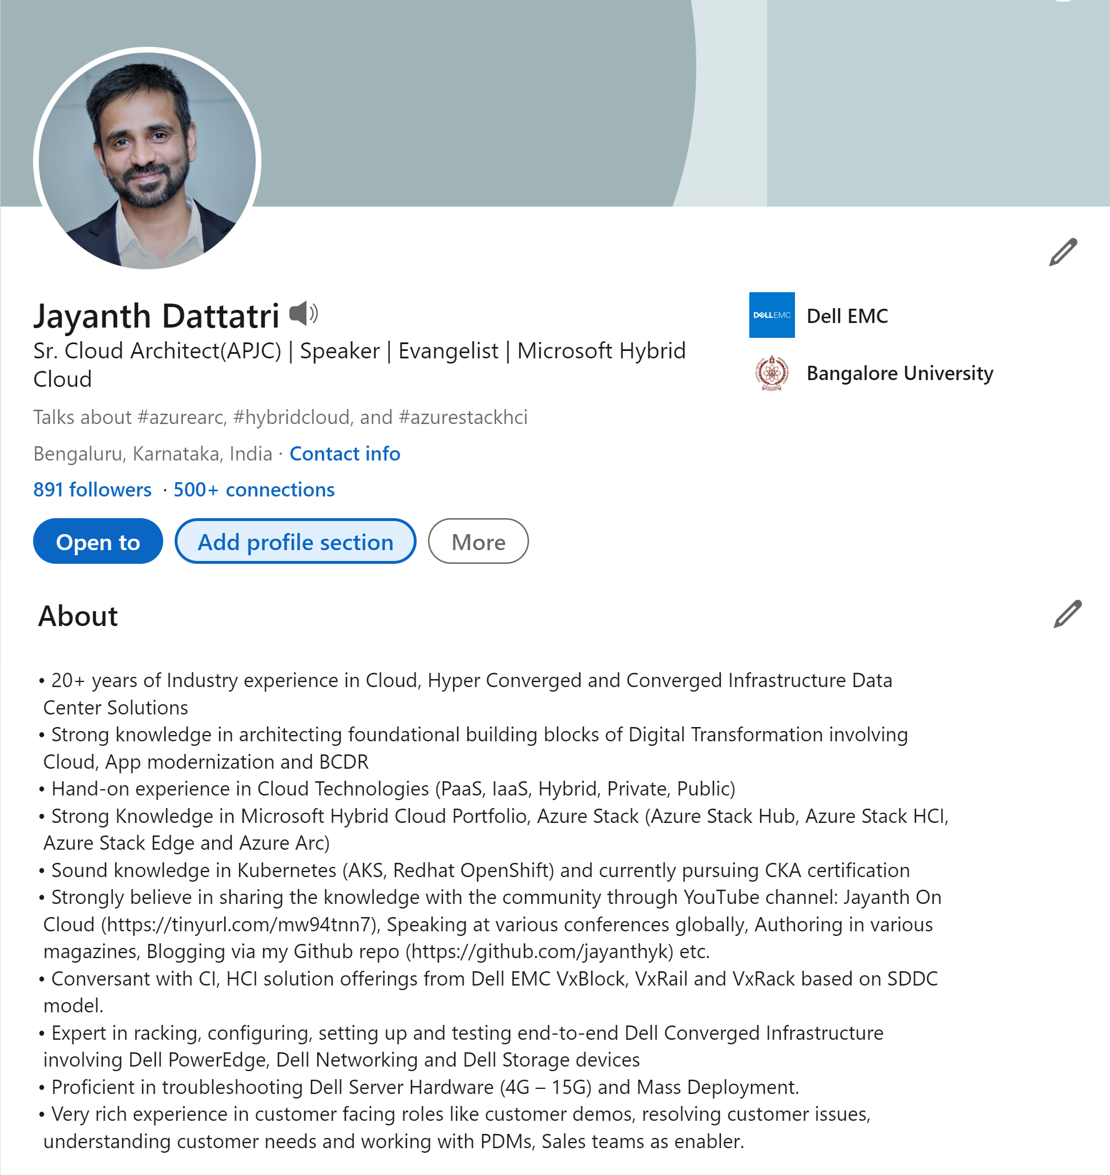
About Me

Slide 4
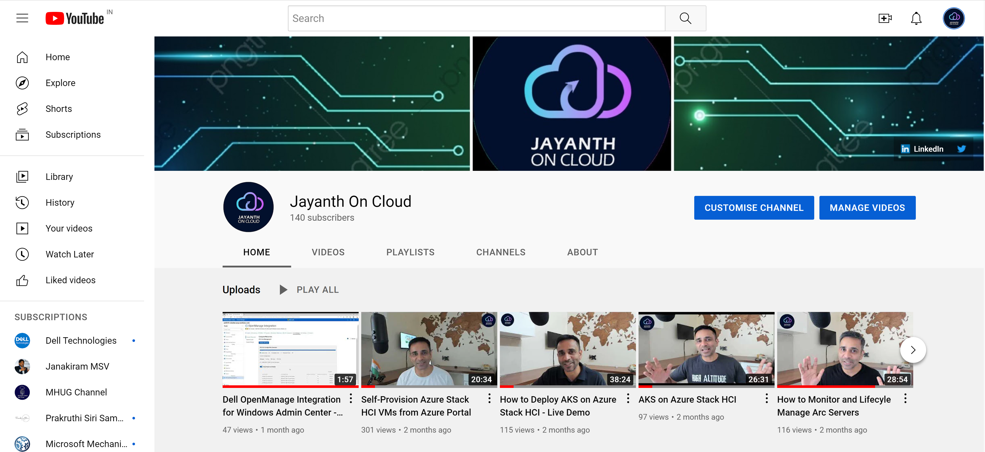
About Me

Slide 5
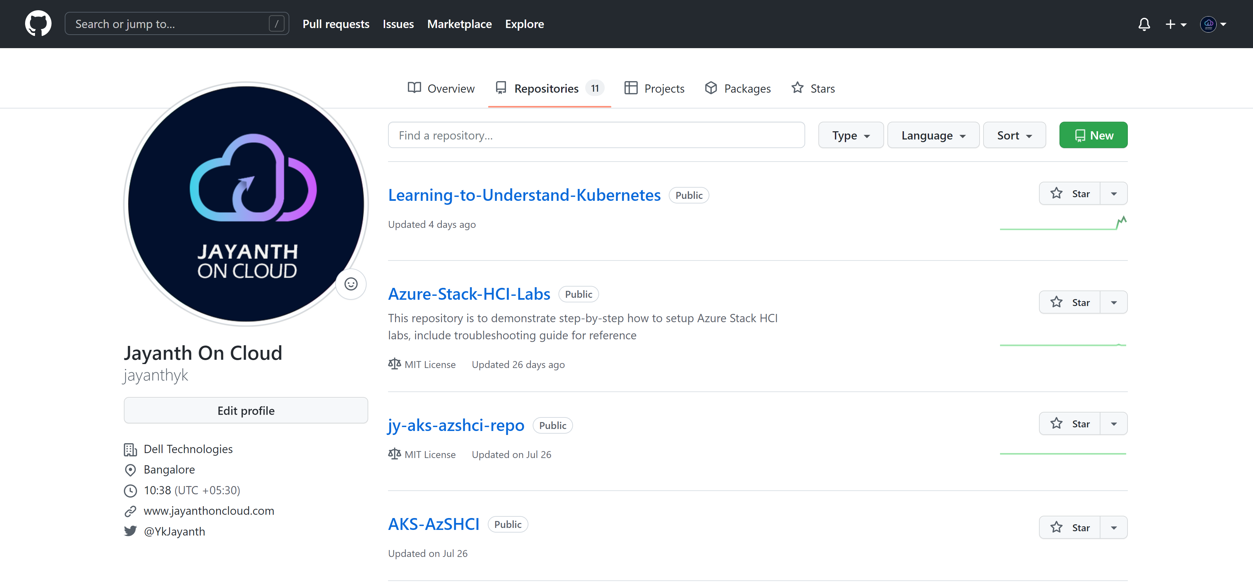
About Me

Slide 6
Agenda
What is Azure Stack HCI
AKS on Azure Stack HCI
Demo
Setting up AKS on Azure Stack HCI
Modernizing Apps using AKS on Azure Stack HCI
Deploying Azure Services on Azure Stack HCI
Q&A
Quiz and Giveaways

Slide 7
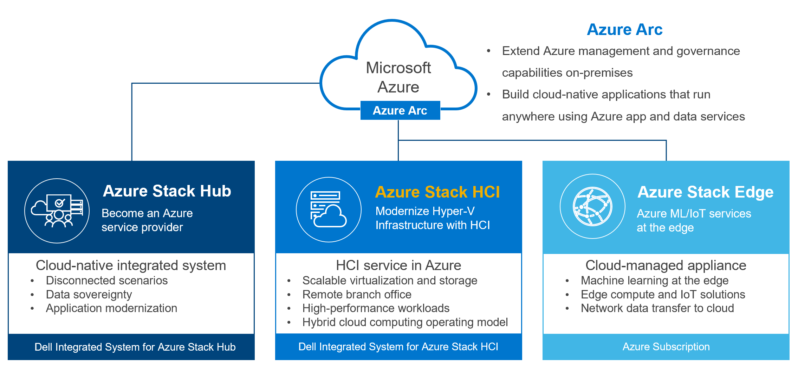
What is Azure Stack HCI?

Slide 8
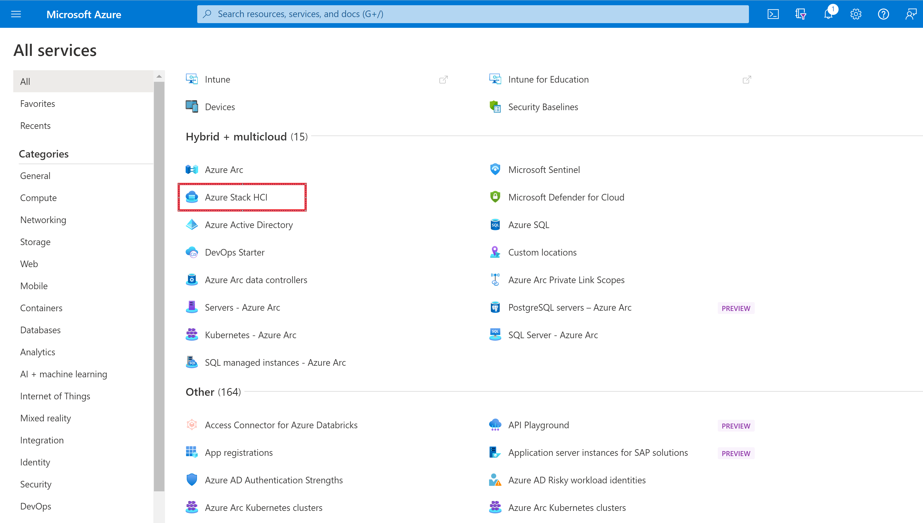
What is Azure Stack HCI?

Slide 9
Azure Kubernetes Service (AKS) on Azure Stack HCI

Slide 10
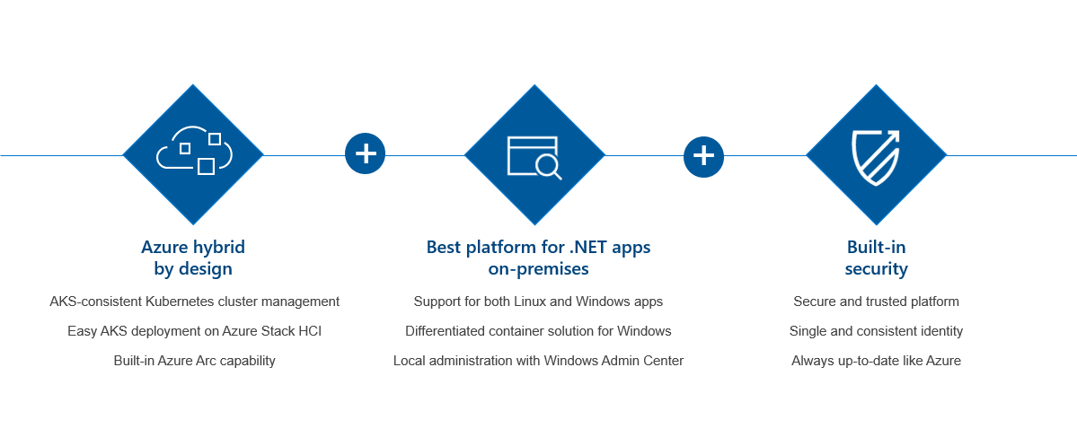
AKS on Azure Stack HCI
Familiar Kubernetes Platform now Available on Azure Stack HCI

Slide 11
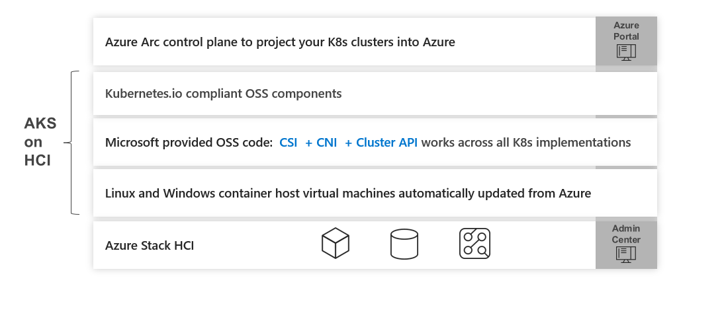
Architecture – High Level

Slide 12
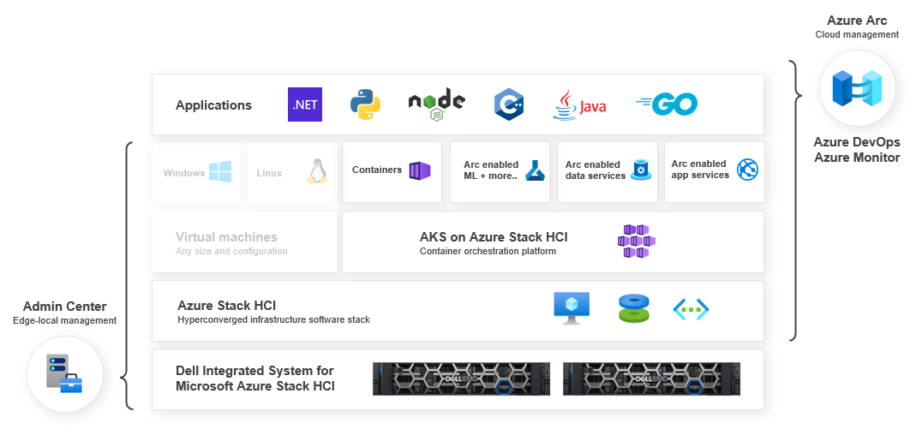
Azure Hybrid Stack with AKS

Slide 13
Demo
Deploying AKS on Azure Stack HCI

Slide 14
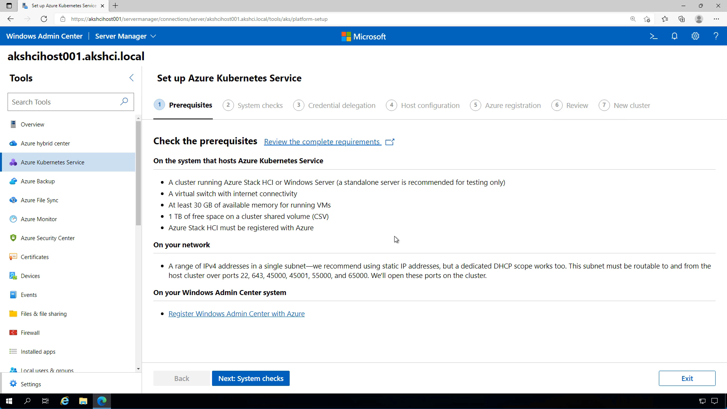

Slide 15
Demo
Creating AKS Cluster Azure Stack HCI

Slide 16
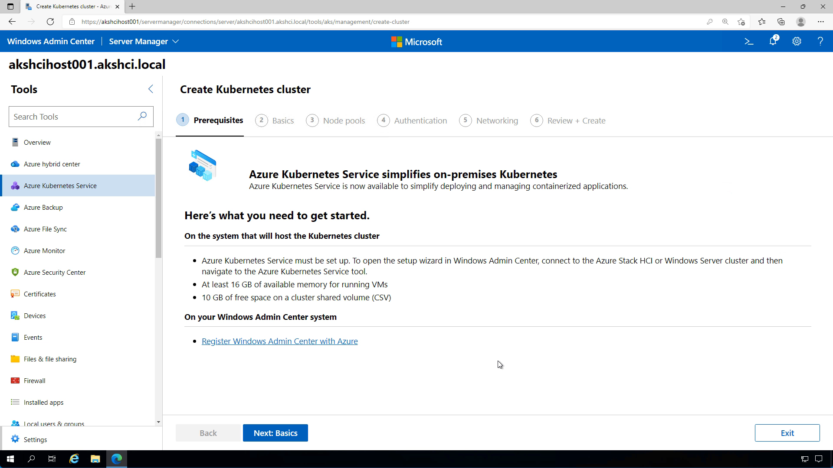

Slide 17
Demo
Deploying Container-based Apps using GitOps

Slide 18
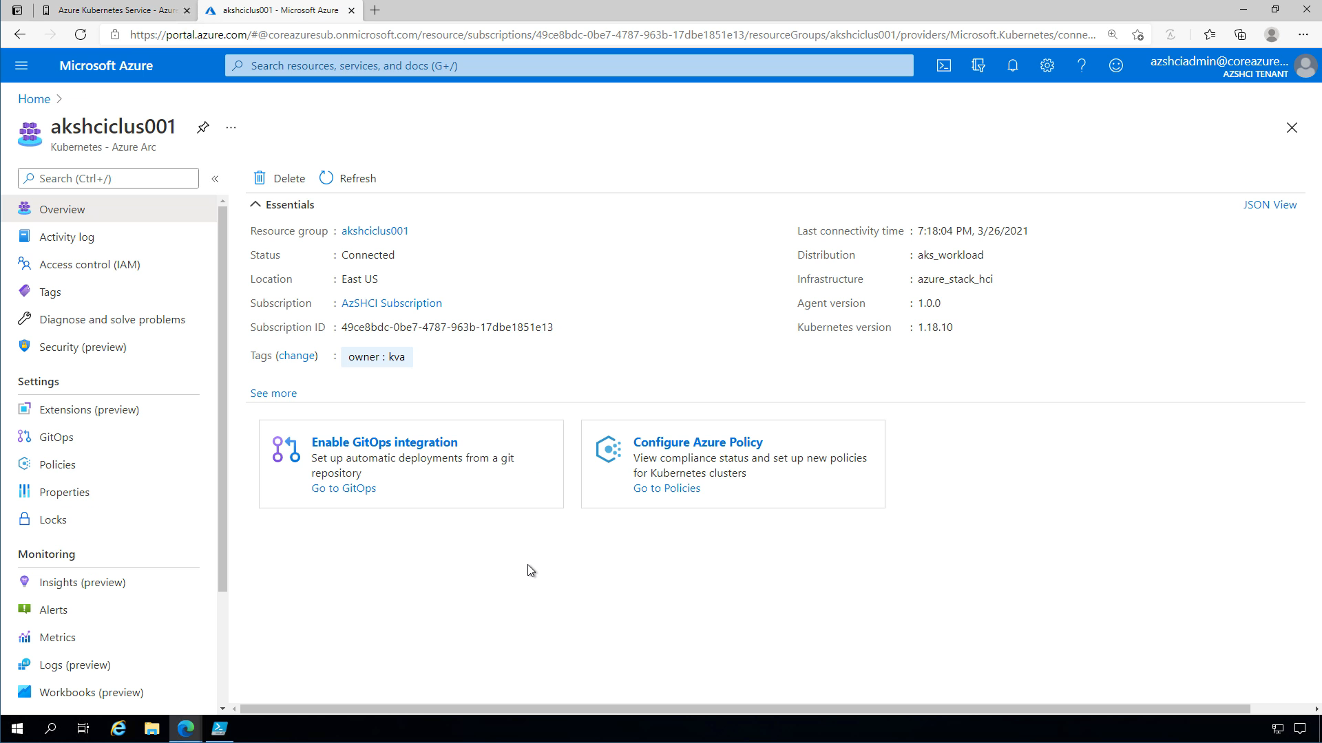

Slide 19
Demo
Deploying Data Services – SQL Managed Instance

Slide 20
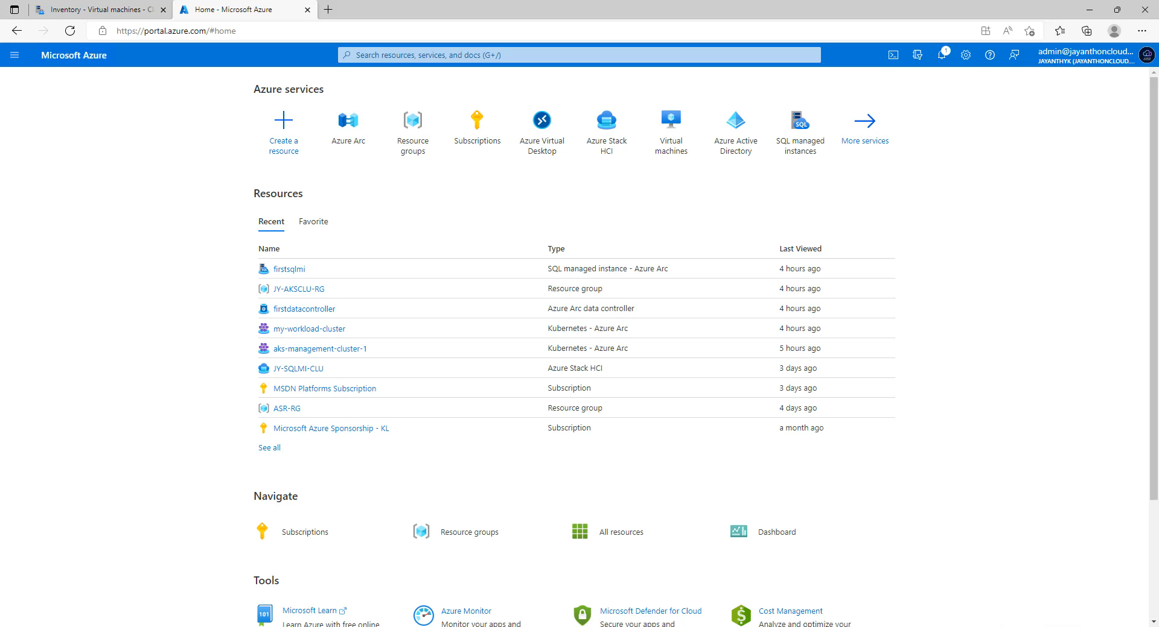

Slide 21
Q&A and Giveaways

Slide 22
Quiz Time
Which of the following products from Microsoft Hybrid Portfolio is used to Modernize ageing 3-tier SAN?
Azure Stack Hub
Azure Stack HCI
Azure Stack Edge
Azure Stack HCI is an Azure Service
True
False
3. Customer would use AKS on Azure Stack HCI
To modernize Infrastructure
To migrate workloads from on-premises to Azure
To modernize on-premises apps and deploy azure services

Slide 23






Platinum Partner
Gold Partner
Silver Partner

Slide 24
Thank You!
AKS on Azure Stack HCI
Jayanth Dattatri YK
Sr. Principal Engineering Technologist Dell Technologies

